Slide 1










Whiteboardmaths.com
7
2
1
5
© 2004 All rights reserved

Slide 2
The Sine Rule
The Sine Rule is used for cases in which the Cosine Rule cannot be applied. It is used to find:
1. An unknown side, when we are given two angles and a side.
2. An unknown angle when we are given two sides and an angle that is not included.
Cosine Rule
19
12
12
a² = b² + c² – 2bcCosA
75º
18
18
Sine Rule
12
12
?
75º
50º
50º
18

Slide 3
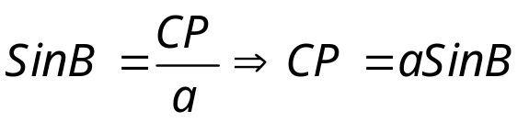
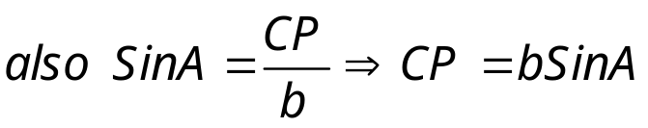

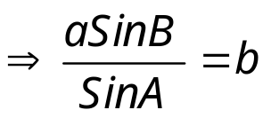
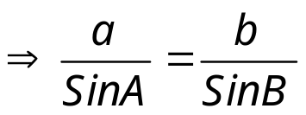
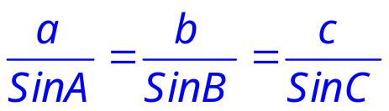
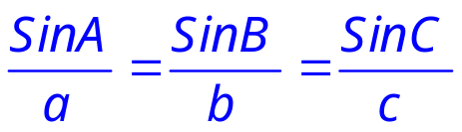
The Sine Rule
Deriving the rule
Consider a general triangle ABC.
C
a
b
P
B
c
A
Draw CP perpendicular to BA
This can be extended to
or equivalently

Slide 4
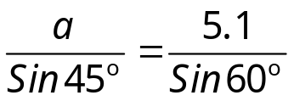
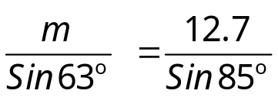
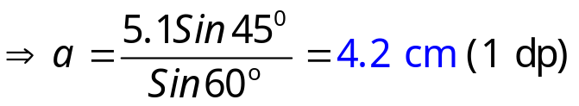
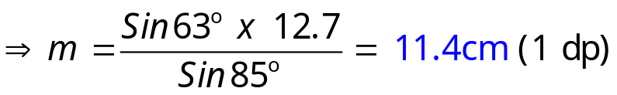
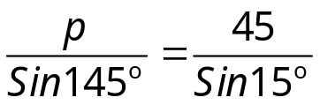
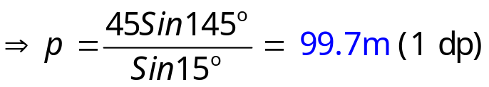
The Sine Rule
To find an unknown side we need 2 angles and a side.
1.
Not to scale
2.
12.7cm
63º
a
5.1 cm
60º
45º
85º
m
3.
15º
p
145º
45 m

Slide 5
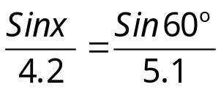
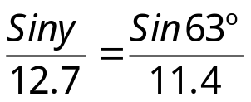
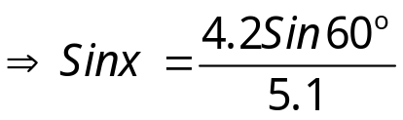
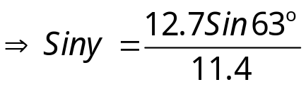


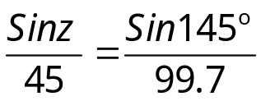
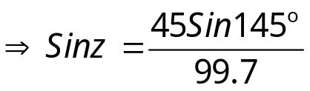

The Sine Rule
To find an unknown angle we need 2 sides and an angle not included.
2.
Not to scale
1.
63º
12.7cm
63º
4.2 cm
5.1 cm
y
y
60º
x
11.4cm
3.
z
99.7 m
145º
45 m

Slide 6

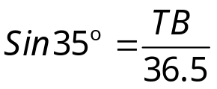
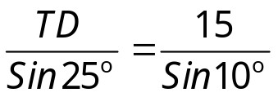

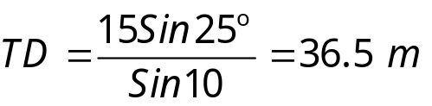
The Sine Rule
The angle of elevation of the top of a building measured from point A is 25º. At point D which is 15m closer to the building, the angle of elevation is 35º Calculate the height of the building.
Application Problems
T
10º
36.5
35º
145º
25º
B
D
15 m
A
Angle TDA =
180 – 35 = 145º
Angle DTA =
180 – 170 = 10º

Slide 7

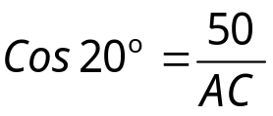
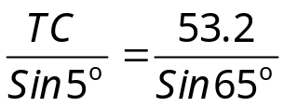
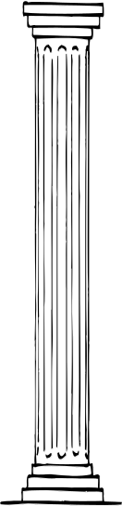
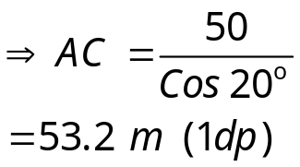
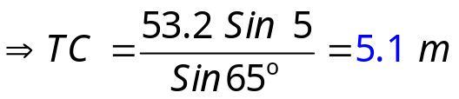
The Sine Rule
The angle of elevation of the top of a column measured from point A, is 20º. The angle of elevation of the top of the statue is 25º. Find the height of the statue when the measurements are taken 50 m from its base
180 – 115 = 65º
T
180 – 110 = 70º
180 – 70 = 110º
Angle ATC =
Angle BCA =
Angle ACT =
65º
110º
C
70º
53.2 m
5º
25º
20º
A
50 m
B

